Slide 1



The Influence of Bat Speed & Swing Length on Fouling Off 2-Strike Pitches
Ebenezer Olubayode^{1,} Dr. Daniel Larson¹
¹Sports Data Analytics, Department of Health & Exercise Science, University of Oklahoma, USA
26th June 2025

Slide 2
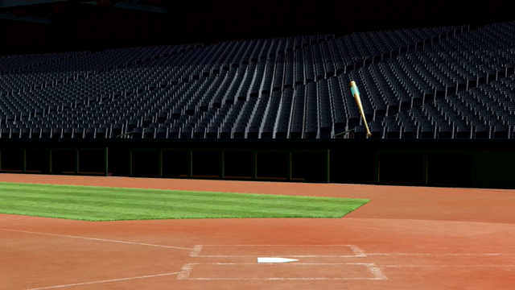
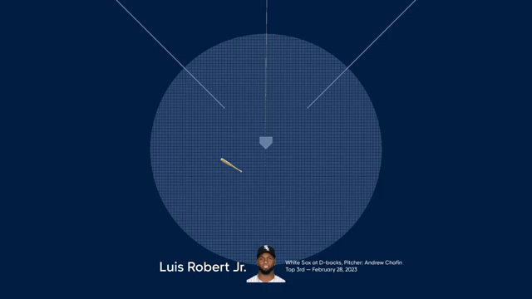
What’s New in MLB Tracking
For the first time, we can measure how hitters move the bat through space:
- Bat speed, Swing path, attack angle
https://technology.mlblogs.com/introducing-statcast-2023-high-frame-rate-bat-and-biomechanics-tracking-3844890264a6
https://www.mlb.com/news/what-you-need-to-know-about-statcast-bat-tracking
MLB Statcast blog and Goldbeck’s blog:
Notes:
In 2023, MLB upgraded its Statcast system with high-speed cameras, letting us track not just pitches, but bats themselves—speed, attack angle, swing path. For the first time, we can measure how hitters move the bat through space

Slide 3
Statcast Ball Tracking Data: Raising New Questions
MLB’s new bat-tracking shifts analysis from outcomes to the swing itself, sparking fresh questions about mechanics, timing, and plate discipline.
Until now, most of what we knew came from what happened after contact; exit velocity, launch angle, hit outcome.
How do different swings shape plate discipline?
Can bat speed predict fouling ability in 2-strike counts? etc.
MLB clubs are exploring these questions to gain an edge
Notes:
The availability of these bat tracking data has opened the door to an entirely new class of questions, especially those ones that we couldn’t answer before.
But now, we can ask:

Slide 4
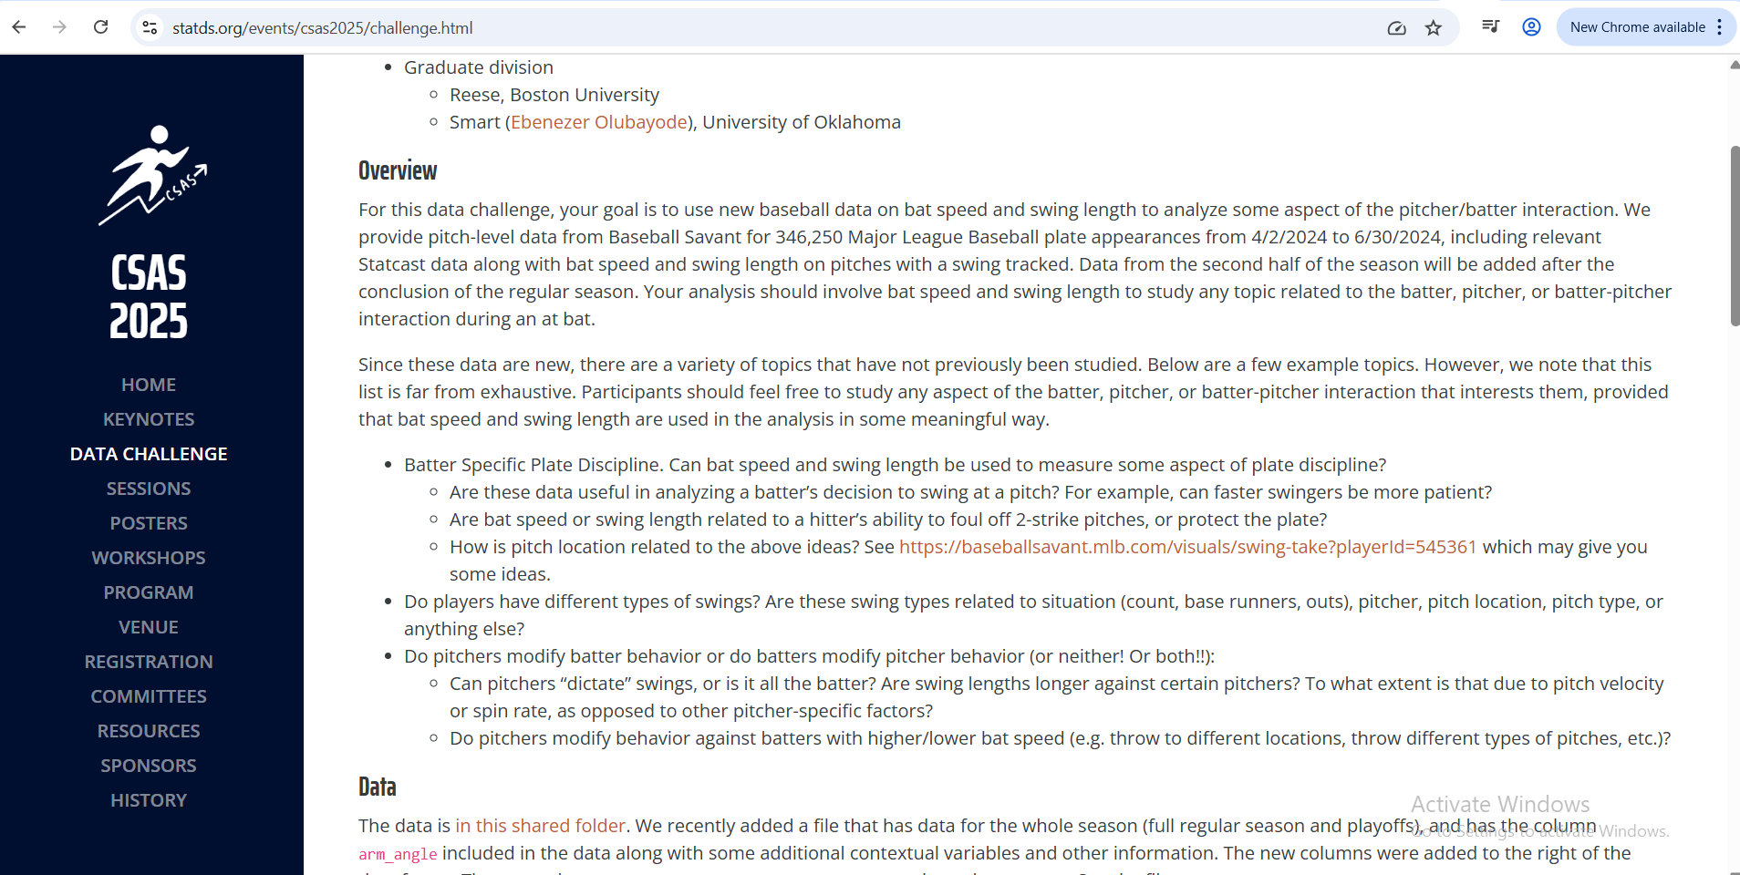
Connecticut Sports Analytics Symposium (CSAS)
https://statds.org/events/csas2025/challenge.html
Notes:
`

Slide 5
Why Investigate Swing Mechanics in 2‑Strike Fouling?
Foul-rate behavior in two-strike situations isn’t a fixed skill but variable and context-dependent.
This hints at underlying factors driving those outcomes.
Foul rate rises in 2-strike counts but isn’t consistent year-to-year.
Implies fouling isn’t just talent-based but situational and mechanical
Situational adjustment: Hitters clearly adapt under pressure but how mechanically?
🔍 Could bat speed and swing length be part of that adaptation?
Mechanical dependency: The article suggests fouling is tied to mechanics, not skill.
✅ supporting the investigation into how specific swing traits influence fouling probability.
Fox Sports. (2020, March 5). Is fouling off pitches a skill? https://www.foxsports.com/stories/mlb/is-fouling-off-pitches-a-skill
Notes:
So why study mechanics?
According to article publish by Fox in 2020, they mentioned that fouling-off ability isn’t a static skill—it changes year-to-year and depends on context.
What this suggests is that there is something deeper is at play — likely mechanics and context.
So the question now becomes: Are variables like bat speed or swing length part of that adjustment under pressure?
This gives us a reason to look into how specific swing mechanics might influence a hitter’s ability to foul off 2 strikepitches

Slide 6
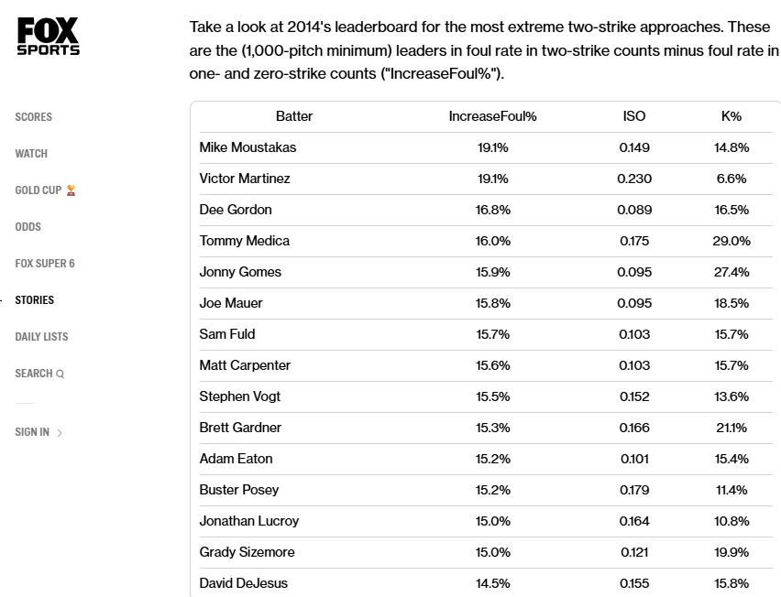
Why Investigate Swing Mechanics in 2‑Strike Fouling?
Victor Martinez:
He fouls off 19% more pitches with 2 strikes than with 0–1 strikes.
Low K% (6.6%) and High ISO (0.230), he’s not just fouling off, he’s protecting plate & producing power.
Tommy Medica:
+16.0% IncreaseFoul%, but K% = 29.0%: Despite increasing foul rate, he still strikes out a lot.
Suggests his fouling doesn’t even reduce strikeouts , possibly due to mechanics, swing decisions, or pitch quality.
Not all succeed equally, and
The variation across players hints at deeper factors (like swing mechanics).
Fox Sports. (2020, March 5). Is fouling off pitches a skill? https://www.foxsports.com/stories/mlb/is-fouling-off-pitches-a-skill
Notes:
This type of model shows both adjustment and control
could that deeper factor be bat speed and swing length?
IncreaseFoul%; The change in foul-ball rate in 2-strike counts compared to 0–1 strike counts

Slide 7
Why 2-Strike Fouls Matter?
Fouling off 2-strike pitches helps batters extend at-bats, tired pitchers, and increases on-base chances.
For pitchers, preventing fouls is key to finishing counts and converting strikeouts
But how swing mechanics like bat speed and swing length affect this ability remains poorly understood.
Carleton, R. A. (2017, March 22). Baseball Therapy: The Secret Powers of the Foul Ball. Baseball Prospectus. https://www.baseballprospectus.com/news/article/31525/baseball-therapy-the-secret-powers-of-the-foul-ball/
Vock, D., & Vock, L. (2018). Estimating the effect of plate discipline using a causal inference framework: An application of the G-computation algorithm. Journal of Quantitative Analysis in Sports, 14(1). https://doi.org/10.1515/jqas-2016-0029
Notes:
Fouling off 2-strike pitches is an important skill in baseball. For batters, it keeps them in the game longer, wears down pitchers, and boosts the chance of good outcomes. For pitchers, it’s a way to stay in control and set up strikeouts
ISO (Isolated Power)A measure of a hitter’s power: SLG – AVG
K% (Strikeout Rate)% of plate appearances ending in a strikeout (Lower K% with high IncreaseFoul% may indicate a good 2-strike strategy.)

Slide 8

Research Objectives
Quantify how bat speed and swing length influence the likelihood of fouling off 2-strike pitches.
Evaluate how pitch characteristics ( vertical/horizontal movement) interact with swing mechanics to shape fouling outcomes
Fox Sports. (2020, March 5). Is fouling off pitches a skill? https://www.foxsports.com/stories/mlb/is-fouling-off-pitches-a-skill

Slide 9
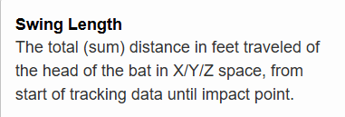
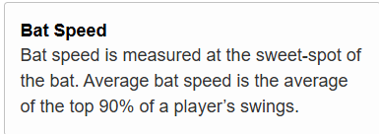
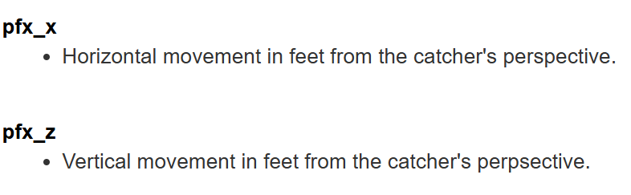
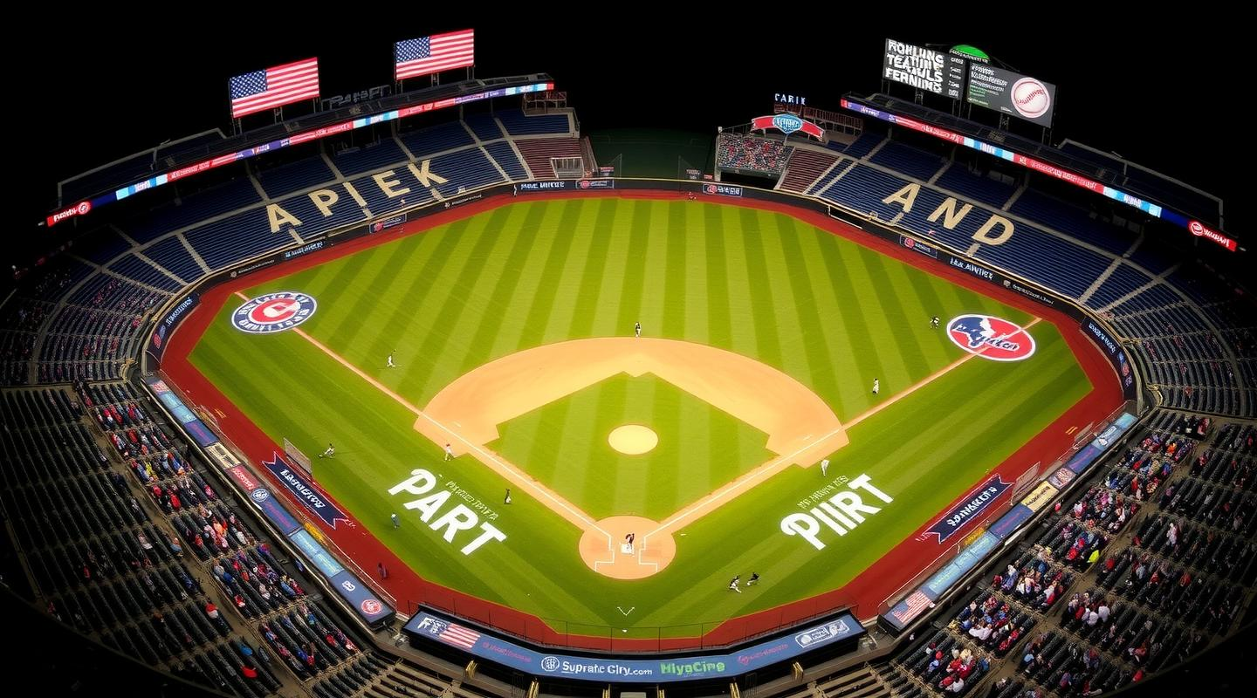

Variable of Interests
Independent Variables
Dependent Variable
Fouling off 2 Strike Likelihood (Y):
A binary outcome variable indicating whether a swing on a 2-strike pitch results in a foul ball (Y = 1) or not (Y = 0, which could be a miss, fair contact, or taken pitch) influenced by pitch type, location, and other factors.
https://baseballsavant.mlb.com/csv-docs
Notes:
Fouling off 2 Strike Likelihood (Y): The probability that a batter makes contact with a 2-strike pitch that results in a foul ball.

Slide 10
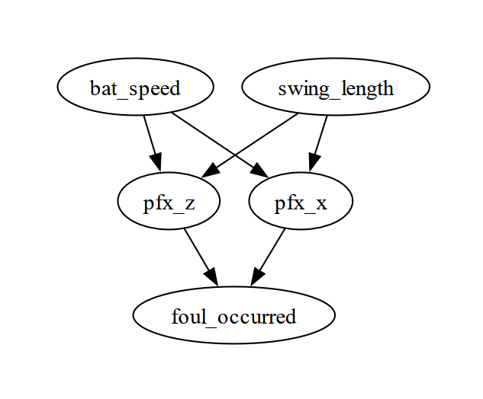
Research Design and Data Collection
Dataset & Preprocessing
Source: Statcast + MLB Savant (Half a season)
Initial rows: 346,250 PAs → cleaning: 58,566
34,159 rows where fouling off 2-strikes didn't occur (foul_occurred = 0)
24,407 rows where a fouling off 2-strikes occurred (foul_occurred = 1)
Study Framework:
Bayesian inference models for causal analysis (Megiddo, 2023).
Why Use Bayesian Modeling?
Allows probabilistic reasoning
Integrates prior knowledge
Outputs full posterior distribution
Used DAGs to establish causal relationships & adjust for confounding variables (Rohrer, 2018; Pearl, 2009).
Drawing the Causal Directed Acyclic Graph (DAG)

Slide 11

Workflow follows a structured process to ensure accurate causal estimates (Lundberg et al., 2021)
Bayesian Inference Workflow for Strike Outcomes
1. Define Generative Model:
2. Define Estimands:
Describe association between the factors (Kahan et al., 2023).
Foul outcomes given the input variables.
3. Design Estimator:
Choose appropriate priors for the coefficients to produce estimands.
Bayesian logistic regression applied to estimate effect size and uncertainty (Gelman et al., 2008).
.
Identify all interested variables related to fouling off 2 strikes
Formulate the logistic regression model to represent the probability of a foul. (Megiddo, 2023)

Slide 12

Bayesian Inference Workflow for Strike Outcomes
4. Test Estimator:
Generate synthetic data using the generative model to test the estimator
Fit the Bayesian model to the synthetic data and evaluate the estimation accuracy (Gogtay et al., 2021).
5. Analyze and Summarize:
Fit the Bayesian model to the actual data.
Use (Markov Chain Monte Carlo) to sample from the posterior distributions in estimating the distribution of the model's parameters
Interpret the impact of each predictor on the foul outcomes and computes contrast means for hypothesis testing (Wiens & Nilsson, 2016)
High-Density Intervals (HDI) , shows where the true value is most likely to be (Hespanhol et al., 2019).
HDI is significant if it does not include zero

Slide 13
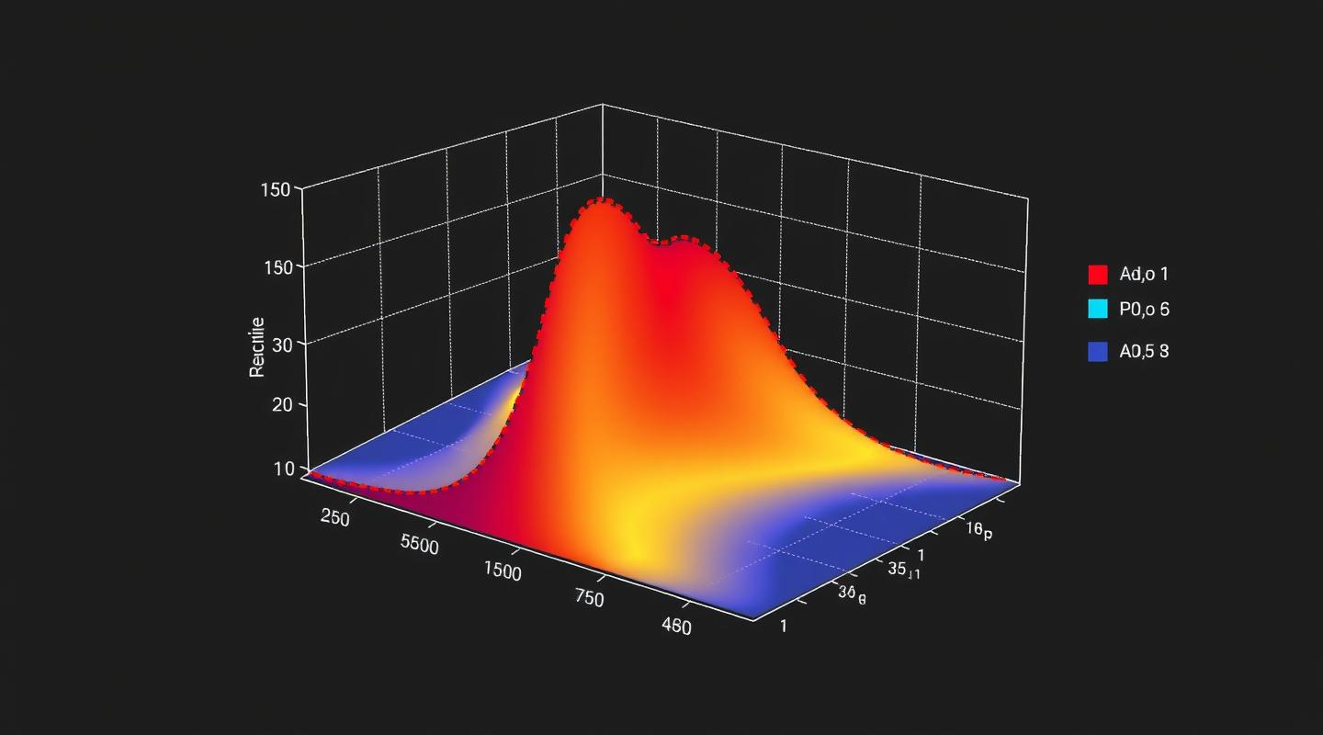
Model Testing and Validation
A rigorous testing was conducted to ensure model accuracy and reliability, (Didelez et al., 2010)
📌 Bayesian Priors and Their Role (Gelman et al., 2008):
Prior distributions represent existing knowledge before analyzing the data.
In this study, Normal (0,10) priors was used for model coefficients.
Why? This prior assumes no strong initial bias while allowing flexibility in estimation.
It acts as a regularization tool, preventing extreme estimates
Notes:
"I used a *Normal(0, 10)* prior distribution for my coefficients beta. This choice reflects a weakly informative prior, which allows the data to largely determine the outcomes while still incorporating some regularization. The mean of 0 suggests no prior bias towards positive or negative values, and a standard deviation of 10 reflects reasonable uncertainty, assuming that most of the coefficient values will fall within this range based on prior studies or expert knowledge.

Slide 14
Model Testing and Validation
📌 Convergence Diagnostics:
Gelman-Rubin statistic (R-hat) checks chain stability (Hespanhol et al., 2019).
If R-hat = 1, it means the MCMC chains have stabilized, ensuring reliable estimates.
If R-hat > 1.1, it suggests the model hasn’t converged yet, meaning more iterations are needed.
📌 Effective Sample Size (ESS) evaluates MCMC sampling efficiency (Wiens & Nilsson, 2016).
A higher ESS (>1000) means a stable and precise estimate of parameters.
A low ESS suggests more iterations are needed to reduce uncertainty

Slide 15
Results
Factor | Comparison | Contrasts | 95% HDI | Interpretation
Swing Length | Short vs. Long | 48% vs. 37% (-0.11) | [-0.137, -0.082] Significant effect, as HDI does not include zero | Shorter swing lengths increase fouling probability
Bat Speed | High vs. Low | 41% vs. 44% (-0.035) | [-0,062, -0.008] | Higher bat speed slightly reduces fouling probability
Vertical Pitch Movement | Effect with Swing Length | 0.50 | [0.48, 0.53] High certainty of predicted value | Short swings are more effective against high pfx_z.
Bat Speed & Swing Length | High Bat Speed & Low Swing Length vs. High Bat Speed & High Swing Length | -0.105 | [-0.145, -0.063] | Significant effect; Foul rate is 10.5% higher with a short swing, even when bat speed is already high.
Bat Speed & Swing Length | Low Bat Speed & Low Swing Length vs. Low Bat Speed & High Swing Length. | -0.115 | [-0.146, -0.083] | Significant effect; shorter swings increase fouling even with low bat speed
Notes:
This table shows the effect of bat speed and swing length on fouling off 2-strike pitches, both individually and together
The key takeaway is that swing length has a much stronger effect than bat speed.
When a hitter uses a shorter swing, the chance of fouling off increases by 11% compared to a long swing.
Bat speed only shifts foul rates by about 3% — much smaller.
Now, look at the pitch characteristics:
Vertical pitch movement, it makes a big difference.
As vertical movement increases, the chance of fouling off decreases.
That means high-riding fastballs are harder to foul off — but short swings still help hitters stay alive against them. Meaning that High vertical movement makes fouling harder.
Now, looking at combinations:
Whether the bat speed is high or low, short swings consistently lead to higher foul rates.
That means good swing control helps extend at-bats, regardless of raw power.
So overall, fouling off 2-strike pitches is more about mechanics than muscle.”**

Slide 16
Main Findings
🔁 Swing length is the dominant factor:
Short swings have a higher foul rate (48%) compared to long swings (37%), helping batters extend at-bats.
⚡ Bat speed has a smaller effect than Swing length:
But low bat speed shows a slight increase in fouling (44% vs 41%) than high bat speed.
📈 Vertical pitch movement (pfx_z) challenges discipline:
Higher vertical movement reduces fouling, but short swings help batters adjust & maintain contact.
🔗 Interaction effects matter:
The combo of short swings + high bat speed yields the highest fouling probability, showing the importance of mechanics over strength.
Overall swing control matters more than raw power.
Notes:
And the best foul rates happen when a hitter combines a short swing with good bat speed — showing the value of mechanical control over just raw strength.

Slide 17
Skill or Talent? Implication for Player Development
⚾ Fox (2020) noted:
Fouling off 2-strike pitches isn’t just raw talent — it’s a skill
Not all players succeed equally in fouling off 2 strikes pitches… suggesting deeper factors like swing mechanics.
🧪 My findings confirm it:
Foul rates shift with swing length, bat speed, and pitch movement — They not consistent by player.
🧠 Takeaway:
If it’s mechanical, it’s coachable. Hitters can train to adjust, shorten swings, and stay alive — especially in pressure counts.
This means:
Success with 2 strikes comes more from adjustment and control than natural talent.
Notes:
One of the big questions in baseball is whether fouling off 2-strike pitches is just raw talent or a repeatable skill according to fox article in 2020
They also mentioned that not all players succeed equally, which hint that deeper factors like swing mechanics can be a contributing factor.
What I found is that foul rates shift with swing length, bat speed, and pitch movement —
but they are not consistent by player, which means that Fouling off pitches doesn’t happen in the same way for each player across all situations.. This suggests that it’s not a fixed trait.
Instead, it’s mechanical and coachable, meaning hitters can adjust.
So, the ability to foul off tough 2-strike pitches looks more like a trainable skill that is rooted in swing control and not something purely driven by natural talent.

Slide 18
CONCLUSIONS
🧢 For Batters:
Short swings are most effective tool for surviving 2-strike counts,
especially against pitches with ↑ vertical movement.
Bat speed alone has limited impact. Instead, controlled swing mechanics
especially reduced swing length drive plate protection.
⚾ For Pitchers:
To limit fouling, pitchers should induce longer swings by exploiting pitch movement and location.
🎯 Targeting vertical movement (e.g., riding fastballs) can help pitchers finish counts and increase strikeout chances.
Notes:
So, what does this mean for development?
🧢 For batters: Short swings are the most reliable way to survive 2-strike counts — especially against pitches with vertical movement.
Bat speed also helps, but it’s the control, especially the shorter swings that really protects the plate
⚾ For pitchers: The key to limiting foul-offs is inducing longer swings — and that comes from how you use pitch movement and location.
🎯pitchers should also target vertical movement , thus will help them finish at-bats and increase strikeout chances.

Slide 19

Github Code & References
THANK YOU
QUESTIONS ?
Scan this

Slide 20
How Bayesian Markov Chain Monte Carlo Works
Step 1: Set a Prior (What We Believe Before Seeing Data)
Step 3: MCMC Starts Sampling Repeating & Learning
We try different guesses
🧪 Guess 1➝ Maybe a high bat speed results in foul by 5%?
🧪 Guess 2 ➝ “Maybe a high bat speed don’t result by 12%?”
🧪 Trial Guess 3 ➝ “What if it's +2%?”
⬇️
📊 We test each guess by asking:
Does it match the data we saw?
Does it make sense based on our earlier belief?
⬇️
If yes ➝ Keep it more often.
If no ➝ Drop it or keep it rarely.
This back-&-forth helps us learn from both data and belief
MCMC is a trial-and-error engine that keeps the best guesses.
🔮 Prior Belief ➝ "Based on past seasons or coaching experience,
I think a low bat speed probably don’t result in fouling off strikes by ~10%,
but could be wrong, so we open to a wide range of possibilities "
🧠 “That belief is our prior distribution, and it helps us frame expectations.
Example prior distribution: 🎯 N(–0.10, SD = 0.05)
←---|====|================|====|---→
-20% -10% 0% +5%
(Before looking at real data)
Step 2: Real Game Data
This balance is the heart of Bayesian inference
Step 4: Posterior Distribution is Formed
Actual Pitches ➝ [ bat_speed = 85.5mph, result = Fouling off 2 strikes ]
[ swing_lenght= 43inches, result = no No. fouling off 2 strikes]
... (real pitch data from games)
Then we get a final result—a posterior distribution.
←---|====|=======================|====|---→
-15% -10% -5% 0% +5%
This shows where the true effect probably lies (Most likely effect: ~ -10%)
In this case, we now believe with 95% certainty that the real effect of bat speed on 2-strike fouling is between -15% and -5%.
Notes:
I might believe that low bat speed reduces the chance of fouling off 2-strike pitches by about 10% ( expected average effect is 10% decrease).
But I also admit—I could be wrong, so I leave room for a wide range of possibilities. The S.D is low here and it means I am moderately confident but still open to a small range of errors.
2. Now we look at actual MLB pitches. We check the bat speed, swing length, and whether or not the batter fouled off a 2-strike pitch. This gives us real evidence to work with.”
After enough smart guessing and testing, we get a final result—a posterior distribution.
This shows where the true effect probably lies, in this case, we now believe with 95% certainty that the real effect of bat speed on 2-strike fouling is between -15% and -5%.” 📣 “So we’ve updated our belief, based on the data.”

Slide 21
Data Sampling Justification
Selected to balance computational feasibility with posterior estimation reliability.
Literature supports sample sizes of 2,000–5,000 observations for accurate posterior estimation using efficient samplers like NUTS. Gelman et al. (2013); Kruschke (2014); Vehtari et al. (2017).
Larger datasets may be used in future predictive modeling where generalizability is prioritized.
Notes:
No U Turn Sampler
Rare pitch types were excluded to ensure model stability and interpretability

Slide 22

Statistical Analysis – Bayesian Modeling
📌 Confounding & Mediation: DAGs establish causal relationships (Rohrer, 2018; Pearl, 2009). Identifying covariates, mediators, and biases, ensuring valid causal inferences.
📌 Causal structure: Innings treated as confounders; movement modeled as mediator.
📌 Estimation method:
Markov Chain Monte Carlo (MCMC) sampling estimates posterior distributions (Chen, 2024).
Instead of calculating a single best estimate, MCMC samples multiple possibilities ensure that uncertainty in predictions are captured.

Slide 23

Assumptions
📌 Weakly Informative Priors: assume predictor effects follow Normal (0,10) priors, ensuring flexibility while preventing extreme values.
Rover et al. (2020) emphasize the benefits of weakly informative priors in hierarchical models, helping avoid overfitting.
📌 Minimal External Influence: Factors like weather conditions may affect pitch resulting in strike but are assumed (negligible effects).
📌 Assumed that batter-specific behavior could bias strike outcomes, so fixed effects were included to control for individual batting tendencies.
📌 Assumed that pitchers exhibit natural variability in style, so random effects were used to capture individual differences without overfitting.
Notes:
This study relies on several assumptions to facilitate analysis:

